Slide 1

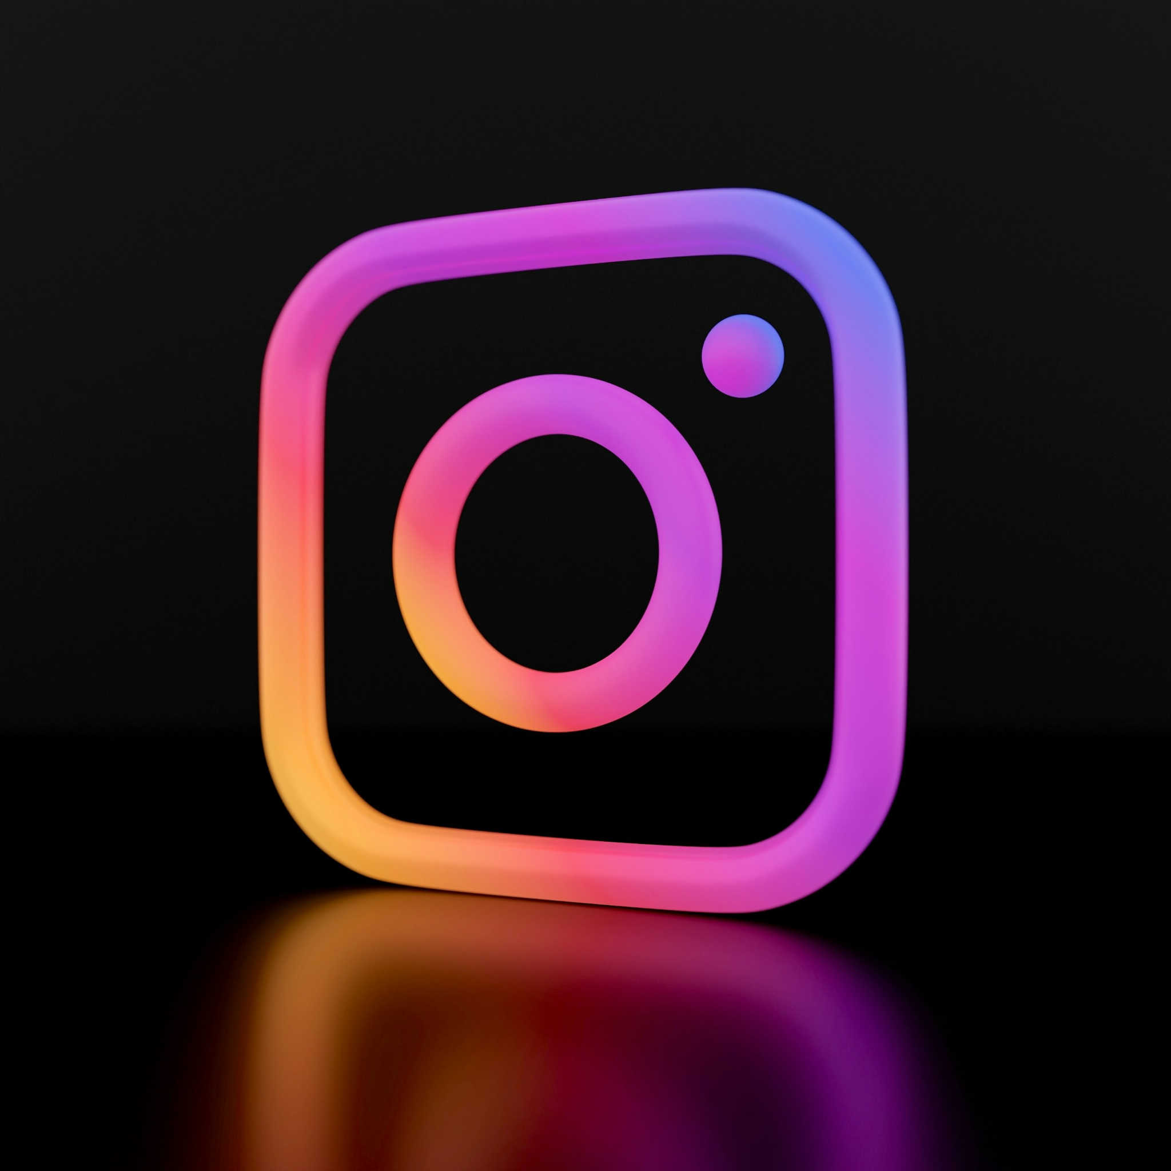
Social Media Analysis
Enhancing User Interaction and Reach
Ms. Achal Zalke

Slide 2
AGENDA
1
2
3
4
5
Problem
Statement
Data
description
Objective Key Metrics and Visualizations
Subjective Question for Insights
Introduction

Slide 3
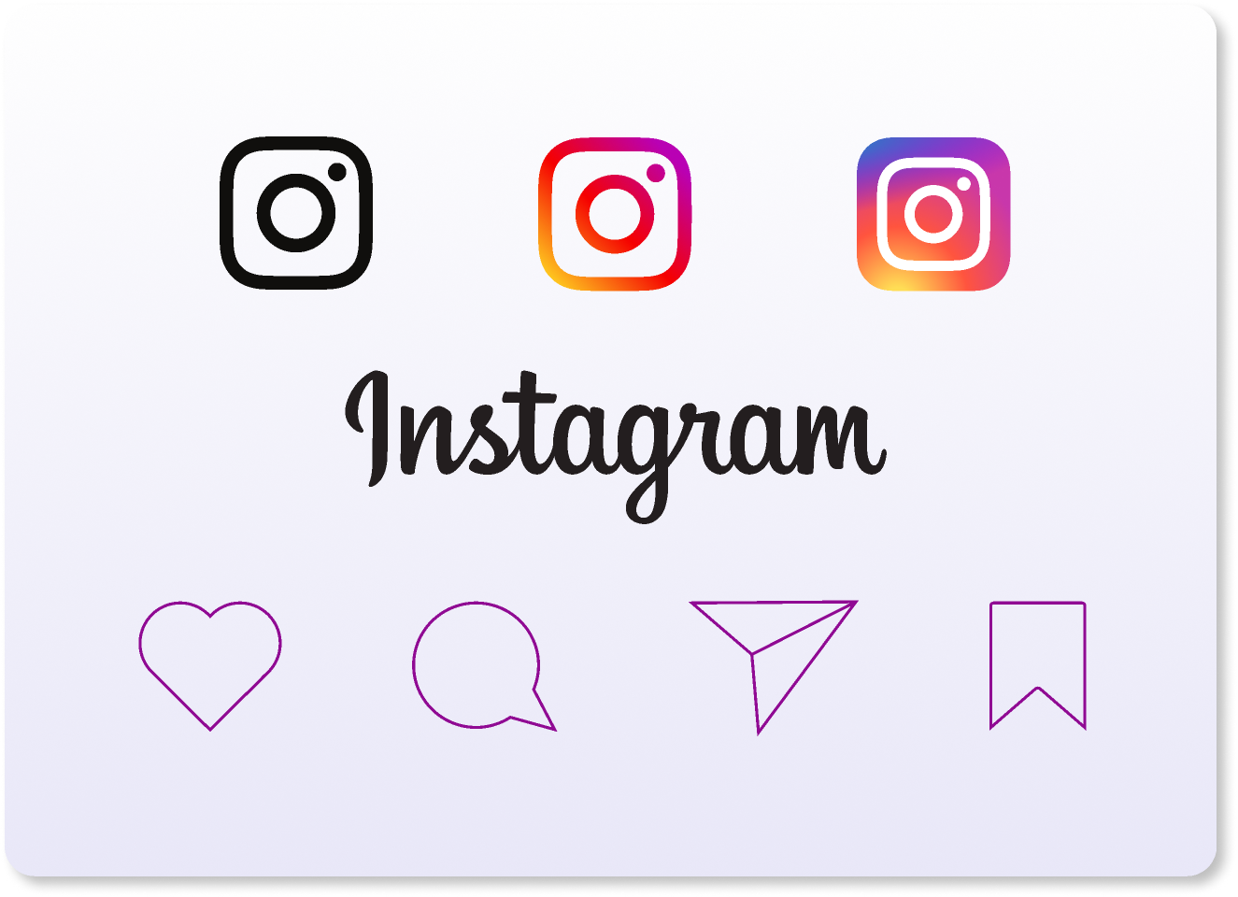
Introduction
instagram is a global leader in social technology, dedicated to connecting people and building communities.
Instagram has transformed from a simple social networking site into a diverse portfolio of applications and technologies that enhance communication and interaction worldwide.
Instagram’s mission is to give people the power to build community and bring the world closer together.

Slide 4

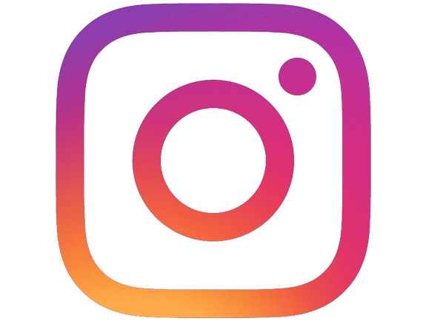
Objectives
Brand Recognition
Marketing
Strategies
Content
Strategies
User Engagement
Ad Campaigns

Slide 5
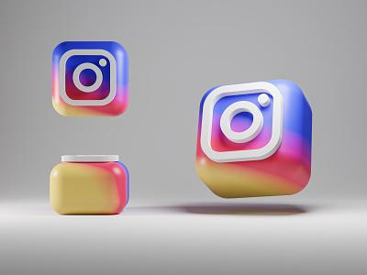
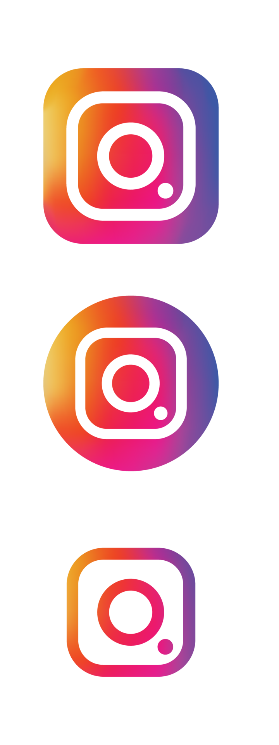
Data overview:
Total Number of users: 100 users
Total number of posts: 257 posts
Total number of likes: 8782 likes
Total number of comments: 7488 comments
Total number of tags: 21 tags

Slide 6
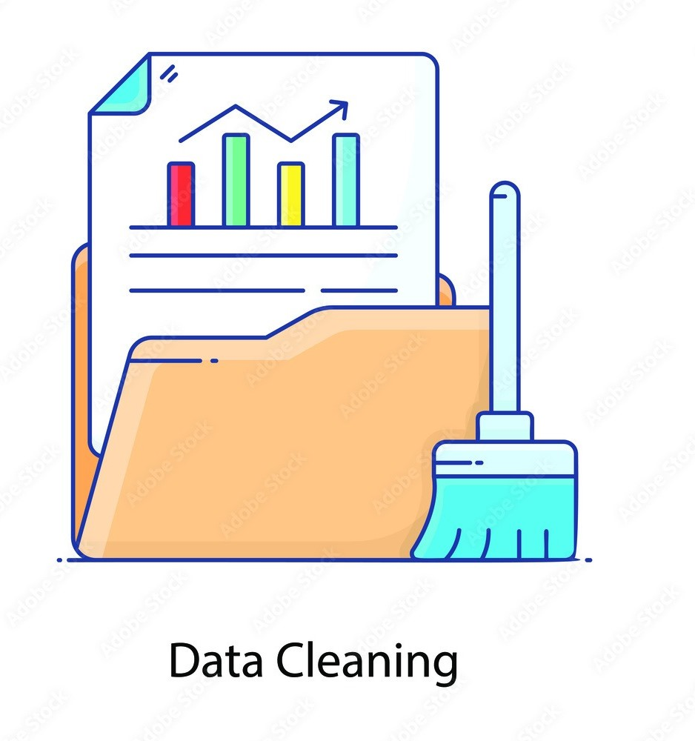

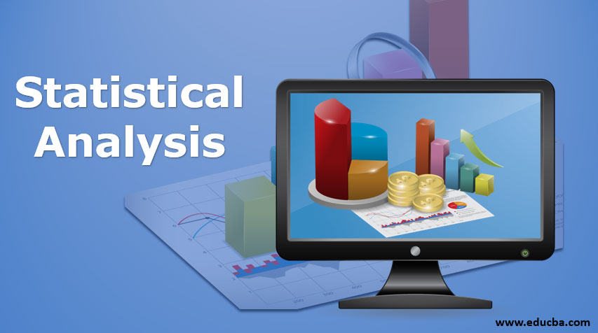
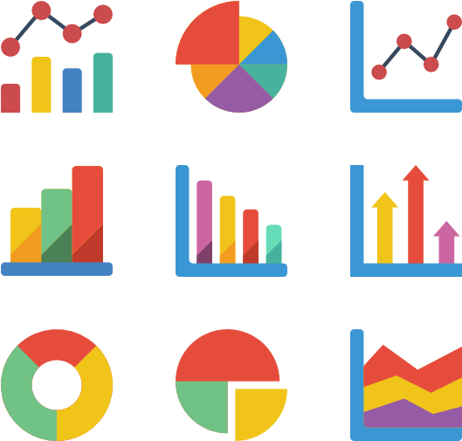
Analytical Approach And Tools
Data cleaning: Using sql function to remove duplicates and remove null values to ensure data accuracy.
Descriptive analysis: Using joins,subquery, window functions
Statistical analysis: conducted analysis using COUNT, AVERAGE , etc.
Visualization: created dynamic charts for better understanding

Slide 7
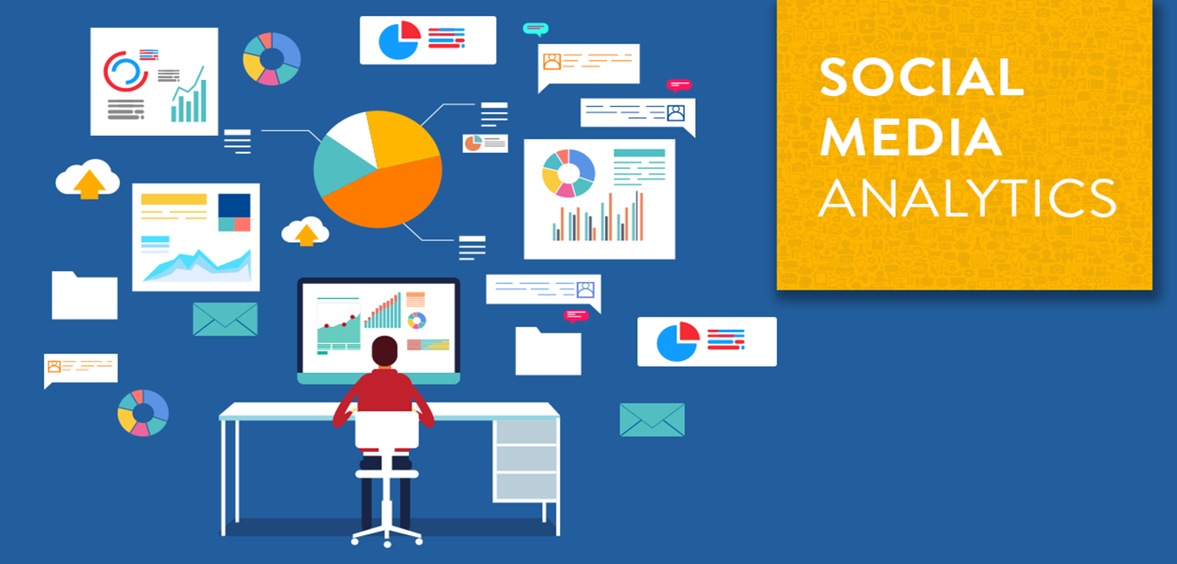
Problem Statement
You are hired as a data analyst at Meta and asked to collaborate with Marketing team. Marketing teams wants to leverage Instagram's user data to develop targeted marketing strategies that will increase user engagement, retention, and acquisition. Provide insights and recommendations to address the following objectives

Slide 8
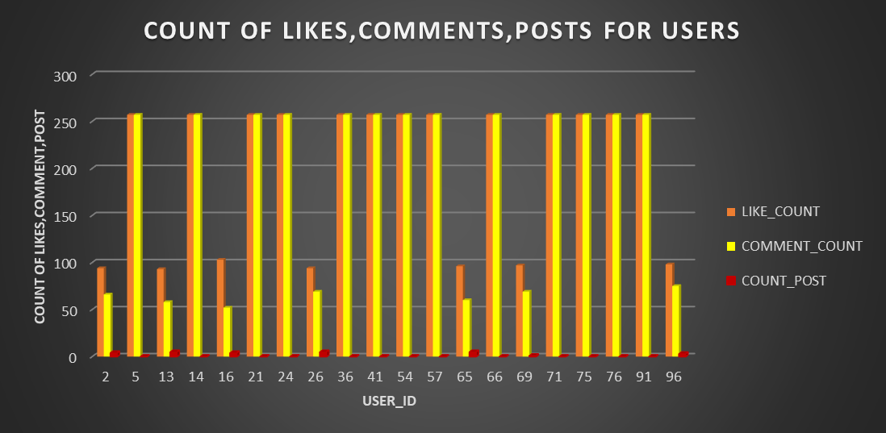
Analysis
It is observed that the users with highest likes and comments are having zero posts as per the query.
And the users with highest no of posts are having zero likes and comments as per the query
In the below graph we can find the users with moderate number of likes, moderate number of comments and moderate no of posts.

Slide 9
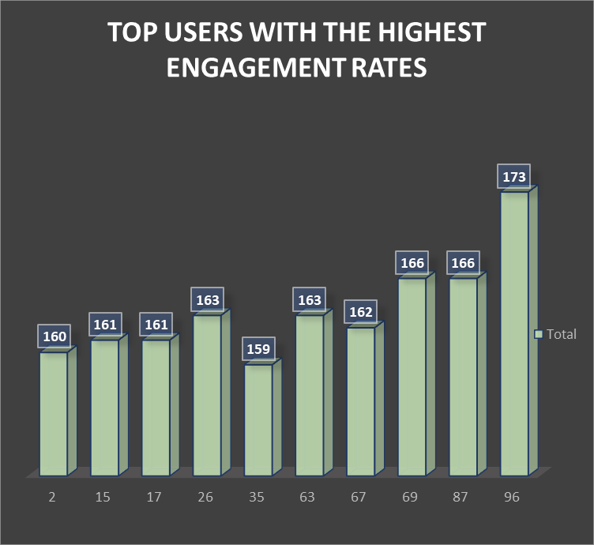
These are the top users with high engagment rate
Engaging with users who demonstrate high engagement rates on social media platforms presents valuable opportunities to amplify brand reach, foster community interaction, and drive meaningful connections.
Strategies:
•Collaborations and Partnerships
•Recognition and Rewards
•Community Building

Slide 10
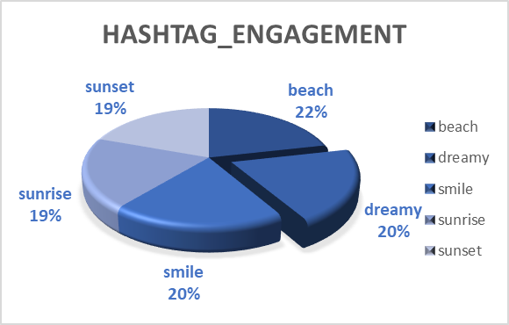
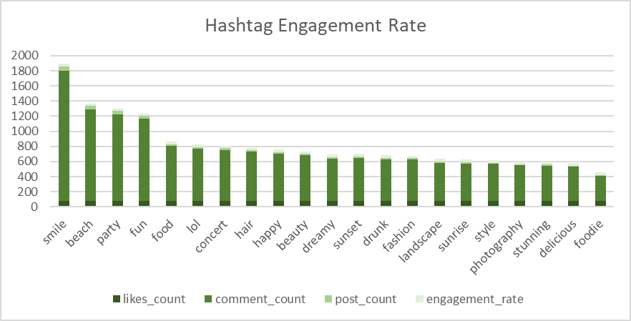
Hashtag Engagement
The top has tags are smile, beach, party and fun.
with this we can create more perosalized and engaging ad campaigns by creating targeted content, leveraging influencers, arranging interactve campains such as party campaign,beauty campaign,beach campaign etc

Slide 11
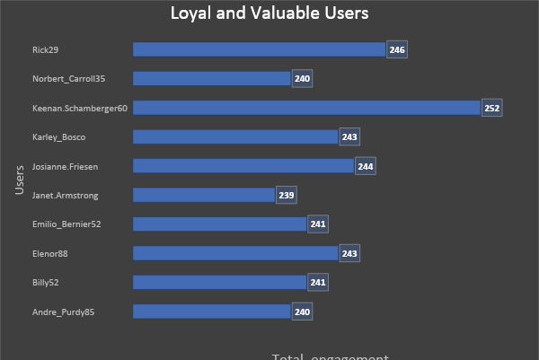
Valuable Users
These are the loyal and valuable users who have highest number of engagement rate
Notes:
E

Slide 12
Correlation Analysis
•High correlation between likes and comments (0.99)
•Negative correlation between likes and photo tags (-0.36)
•Negative correlation between comments and photo tags (-0.37)
•High correlation suggests creating content that encourages both likes and comments
•Negative correlation indicates a need for balancing content to cater to different user behaviors
•Weak correlation suggests potential areas for improving content strategies

Slide 13
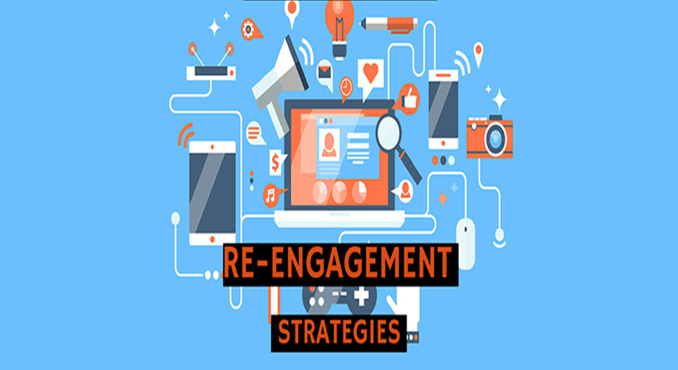
Strategies to Re-Engage Inactive Users
Personalized Re-Engagement Campaigns
Special Offers and Incentives
Content Highlighting and Personalization
Suggest relevant content based on past behaviour
Showcase trending and popular posts
Community and Social Engagement
Feedback and Surveys

Slide 14
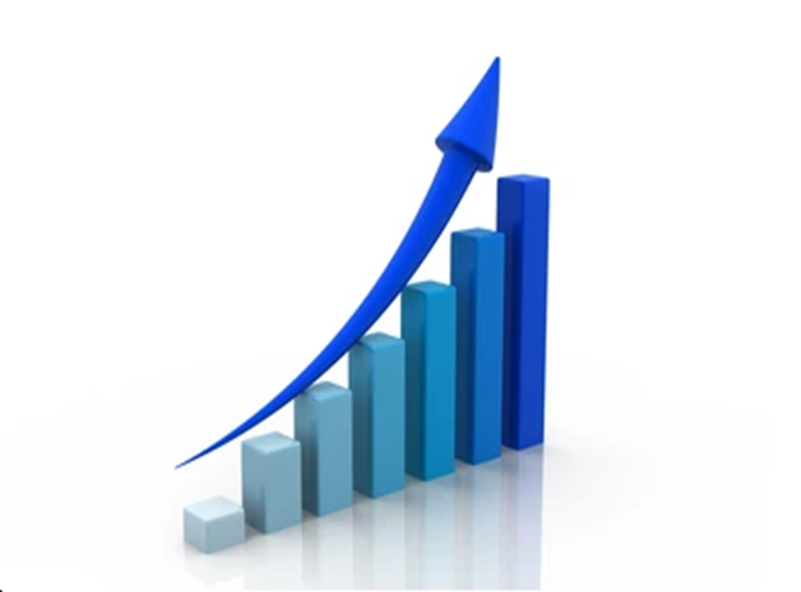
Expected Outcome
•Increased Engagement Rate: Target 15% rise in likes, comments, and shares.
•Enhanced Reach: Aim for 20% growth in content reach through optimized hashtags.
•Boosted User Interaction: Increase user-generated content by 25%.
•Optimized Content Strategy: More effective content delivery based on data insights.
•Improved Hashtag Performance: Target 10% higher engagement from hashtags.
•Successful Campaign Integration: Cohesive brand messaging and enhanced campaign performance.

Slide 15
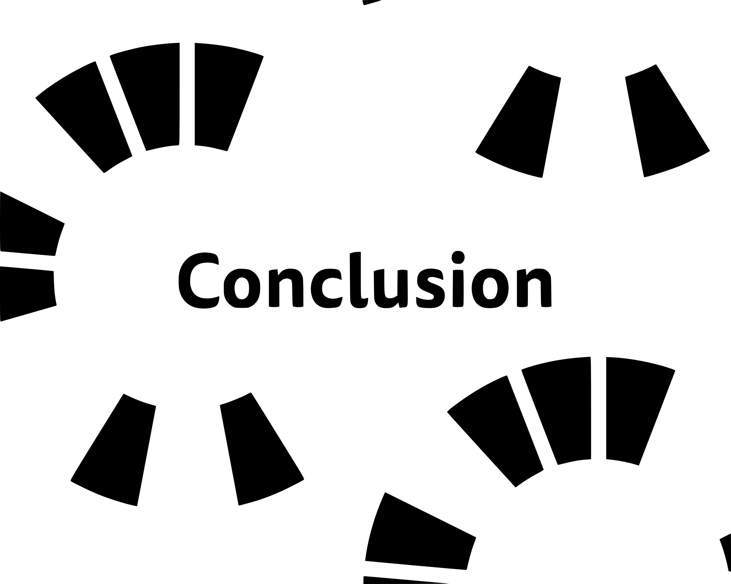
Our data-driven approach has provided valuable insights and effective strategies for enhancing social media engagement. By identifying key metrics and top-performing content, we've developed tactics to boost likes, comments, and shares. Leveraging top users and user-generated content, we aim to create a more engaged community. The implementation plan outlines clear steps, a timeline, and the necessary tools for successful execution.
We expect to see a 15% rise in interactions, a 20% growth in content reach, and a 25% increase in user-generated content. Moving forward, our next steps include executing the plan, continuously optimizing based on data insights, and tracking progress to measure the impact. By leveraging these strategies, we aim to drive meaningful engagement, expand our reach, and build a strong, active community.

Slide 16


